Slide 1
AlphaGo Mastering the game of Go with deep neural networks and tree search
By Ilan Godik

Slide 2
Background: Go history
Created 3,000 years ago
Considered as poetry and art.
Taught at schools in Korea & Japan.

Slide 3
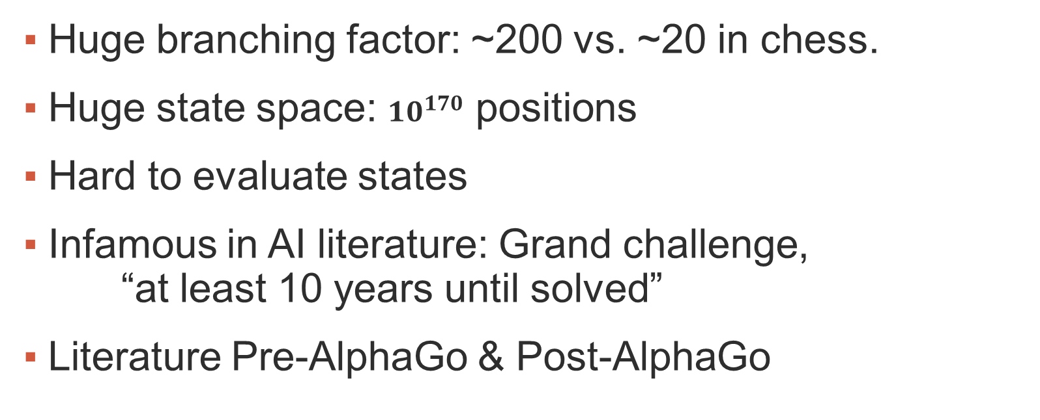
Background: Go in AI
Huge branching factor: ~200 vs. ~20 in chess.
Huge state space: ${10}^{170}$ positions
Hard to evaluate states
Infamous in AI literature: Grand challenge, “at least 10 years until solved”
Literature Pre-AlphaGo & Post-AlphaGo

Slide 4
Rules of Go
Black starts
19x19 board
Each player places a stone in his turn

Slide 5
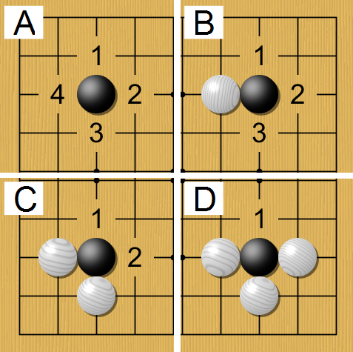
Go: Rule #1
0 Liberties => Stone removed

Slide 6
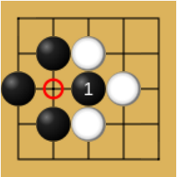
Go: Rule #2
No repeating boards

Slide 7
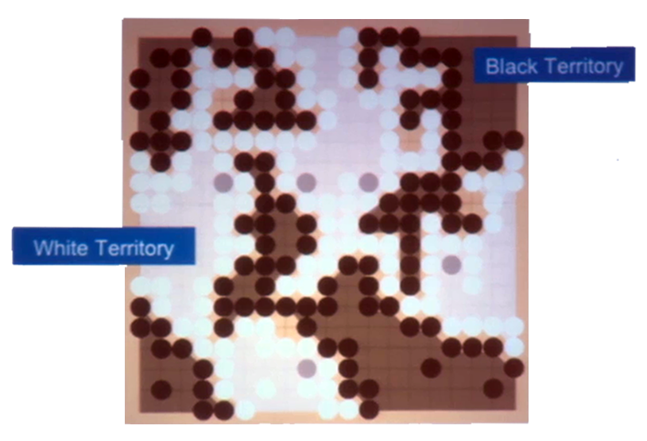
Go: Winner
Stones + Territory

Slide 8
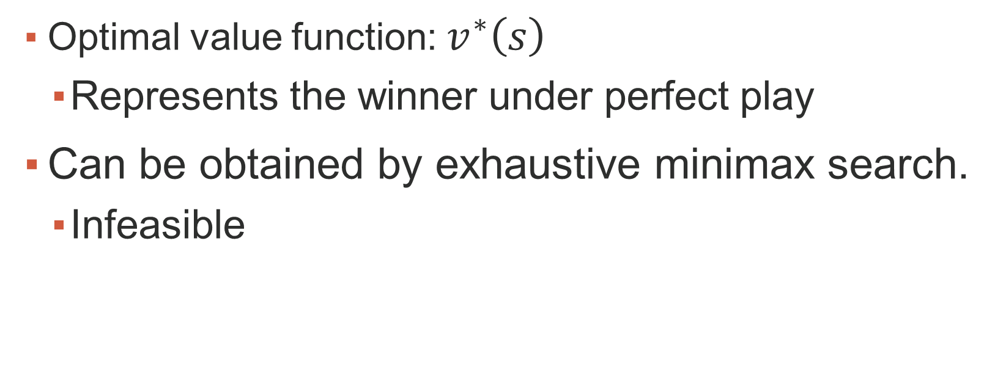
Perfect information Games
Optimal value function: $v^{∗}\left(s\right)$
Represents the winner under perfect play
Can be obtained by exhaustive minimax search.
Infeasible

Slide 9
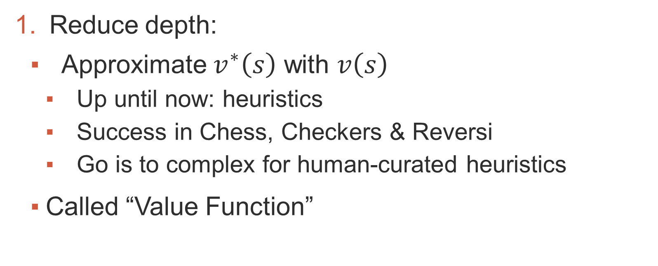
Solution: Reduce Depth
Reduce depth:
Approximate $v^{∗}\left(s\right)$ with $v\left(s\right)$
Up until now: heuristics
Success in Chess, Checkers & Reversi
Go is to complex for human-curated heuristics
Called “Value Function”

Slide 10
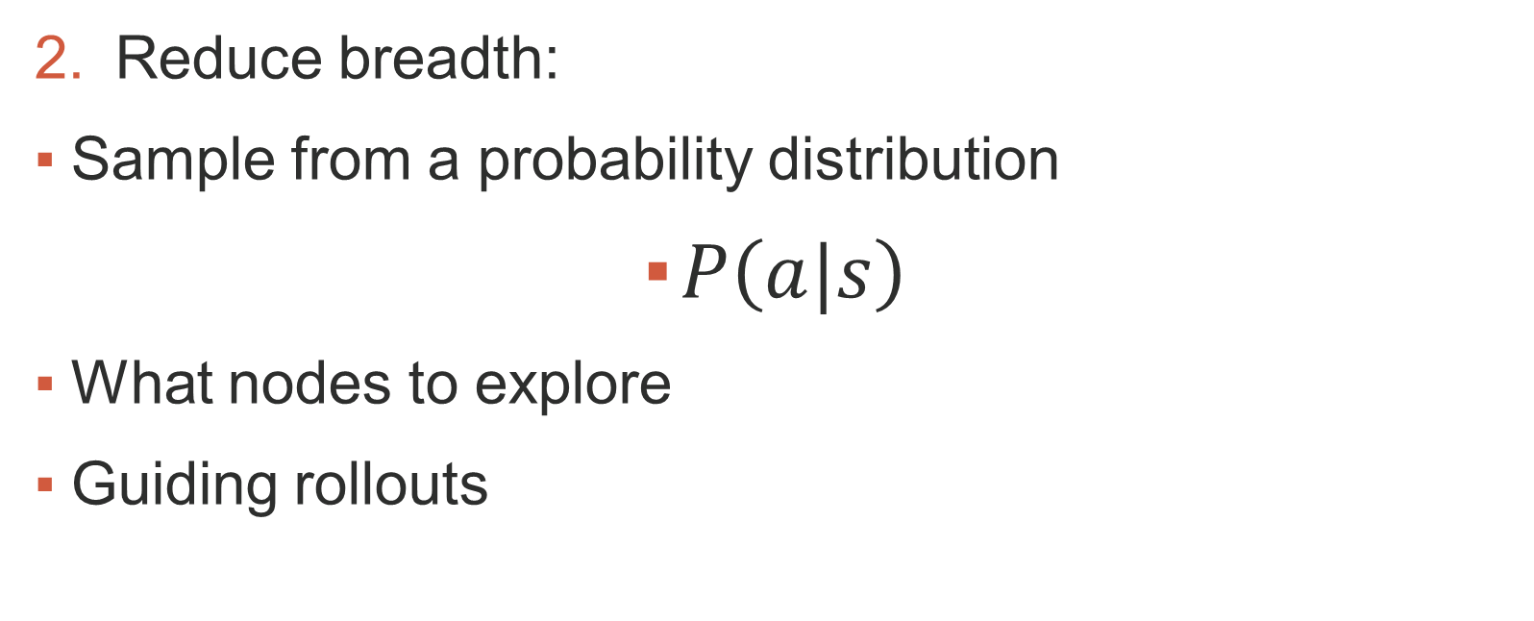
Solution: Reduce Breadth
Reduce breadth:
Sample from a probability distribution
$P\left(a|s\right)$
What nodes to explore
Guiding rollouts

Slide 11
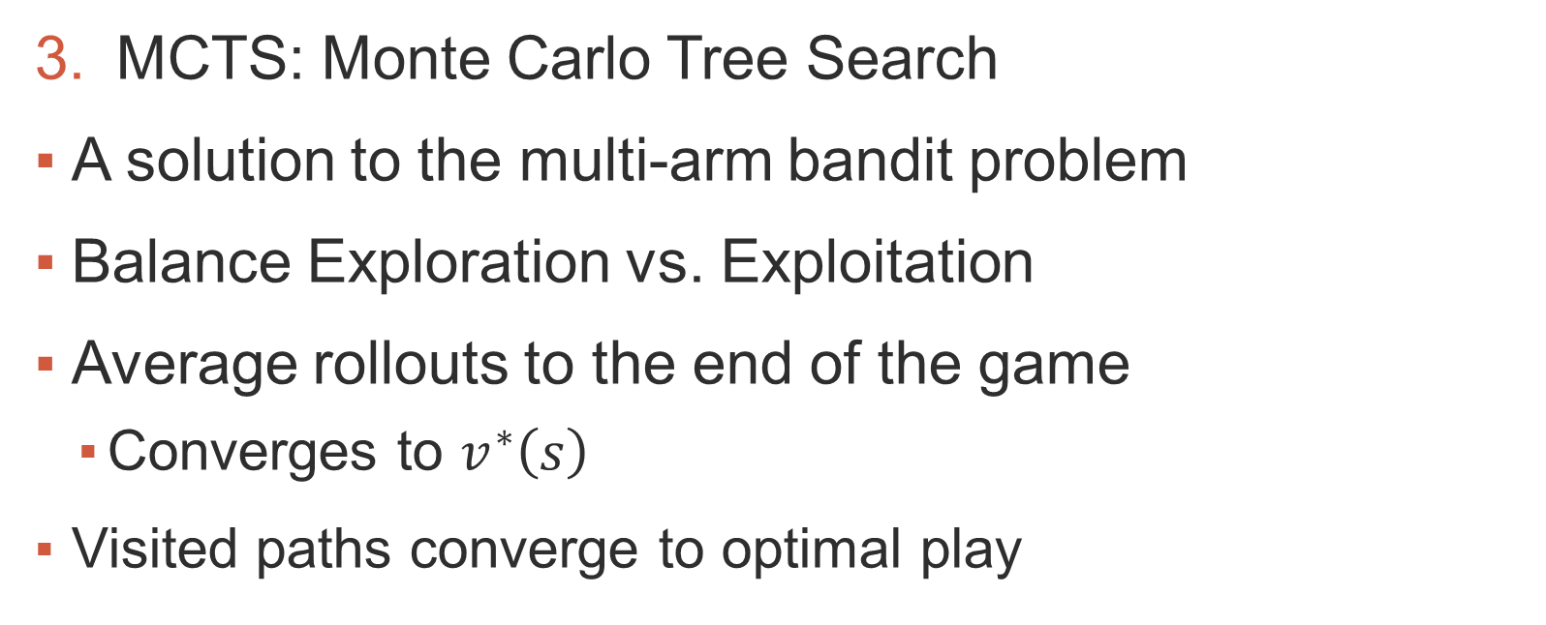
Solution: MCTS
MCTS: Monte Carlo Tree Search
A solution to the multi-arm bandit problem
Balance Exploration vs. Exploitation
Average rollouts to the end of the game
Converges to $v^{∗}\left(s\right)$
Visited paths converge to optimal play

Slide 12
Previous attempts
Policies & Value functions were heuristic
Linear combinations of hand-crafted features

Slide 13
Deep Convolutional Neural Networks
Huge success:
Image classification
Face recognition
Playing Atari games
Many layers of neurons
Overlapping patterns, convolutional layers
Increasingly abstract & localized representation of the input

Slide 14
AlphaGo overview
Policy Networks
Value Network
MCTS
Distributed Computation & Time management

Slide 15
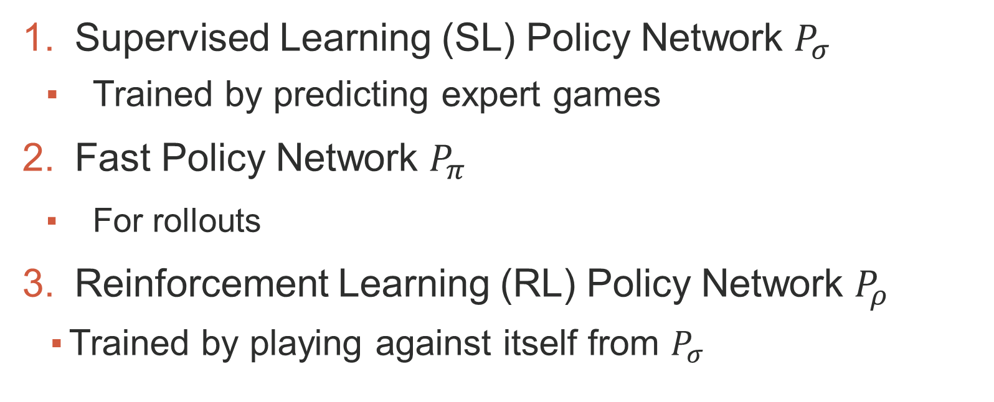
Policy Networks
Supervised Learning (SL) Policy Network $P_{σ}$
Trained by predicting expert games
Fast Policy Network $P_{π}$
For rollouts
Reinforcement Learning (RL) Policy Network $P_{ρ}$
Trained by playing against itself from $P_{σ}$

Slide 16

Value Network
Learn the winner from the self-play games of $P_{ρ}$
(The Reinforcement Learning policy network)
Outputs a single scalar: $v_{θ}\left(s\right)$

Slide 17
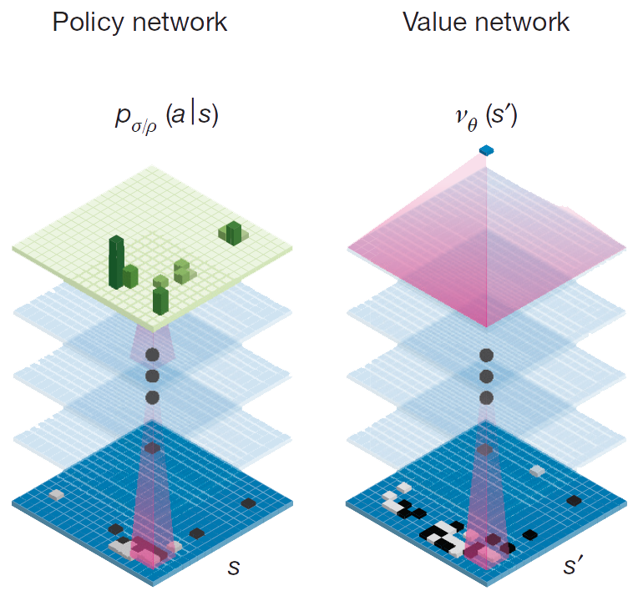
Policy & Value Networks

Slide 18
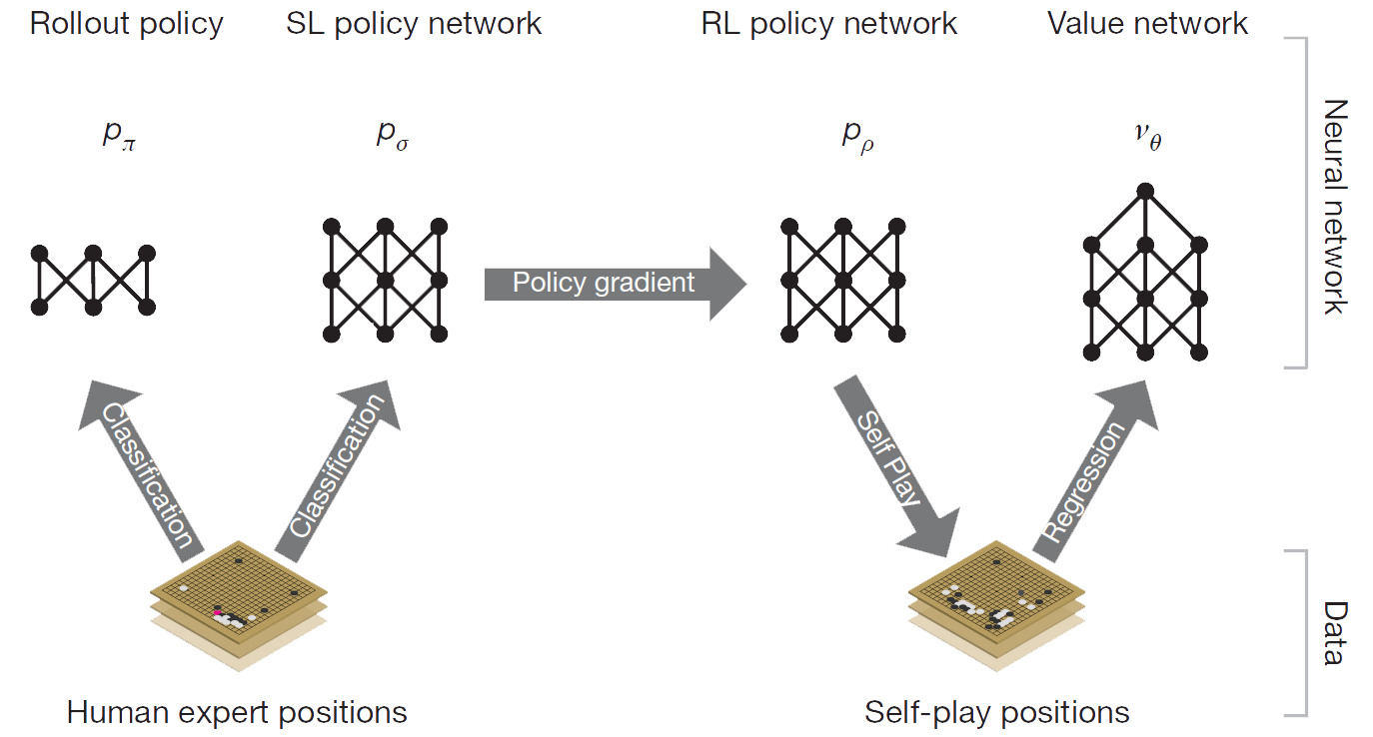
Training Overview

Slide 19
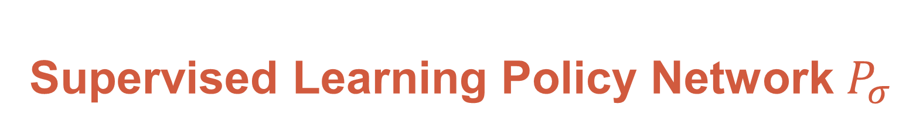
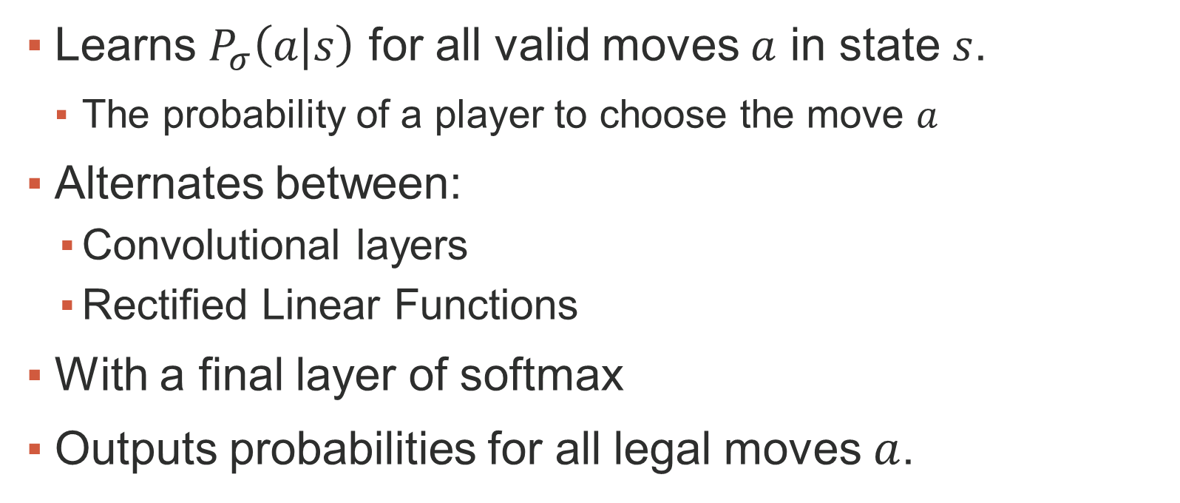
Supervised Learning Policy Network $P_{σ}$
Learns $P_{σ}\left(a|s\right)$ for all valid moves $a$ in state $s$.
The probability of a player to choose the move $a$
Alternates between:
Convolutional layers
Rectified Linear Functions
With a final layer of softmax
Outputs probabilities for all legal moves $a$.

Slide 20
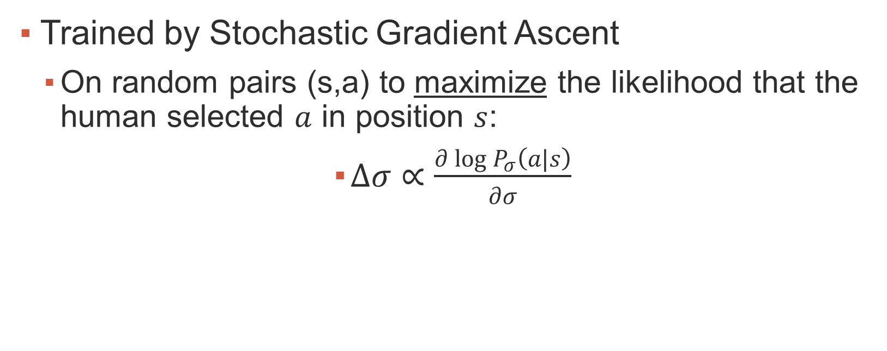
Supervised Learning Policy Network $P_{σ}$
Trained by Stochastic Gradient Ascent
On random pairs (s,a) to maximize the likelihood that the human selected $a$ in position $s$:
$Δσ∝\frac{∂\log{P_{σ}\left(a|s\right)}}{∂σ}$

Slide 21
Supervised Learning Policy Network $P_{σ}$
13 Layer neural network
Dataset: 30 Million games from the KGS Go Server
Augmented with Rotations & Reflections
~3 weeks to train on 50 GPUs

Slide 22
SL Policy Network: Features
Features:
Stone colors
Liberties before & after
Number of stones captured
3 other basic move properties

Slide 23
SL Policy Network Evaluation
Accuracy in predicting player moves:
57.0% success on all features
55.7% success on board + move history only
Improved the state-of-the-art of 44.4%

Slide 24
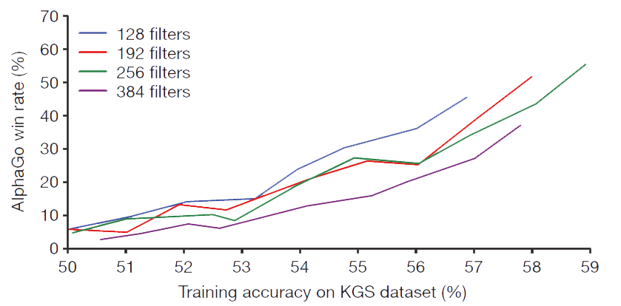
SL Policy Network Evaluation
Every percent gives HUGE playing power

Slide 25

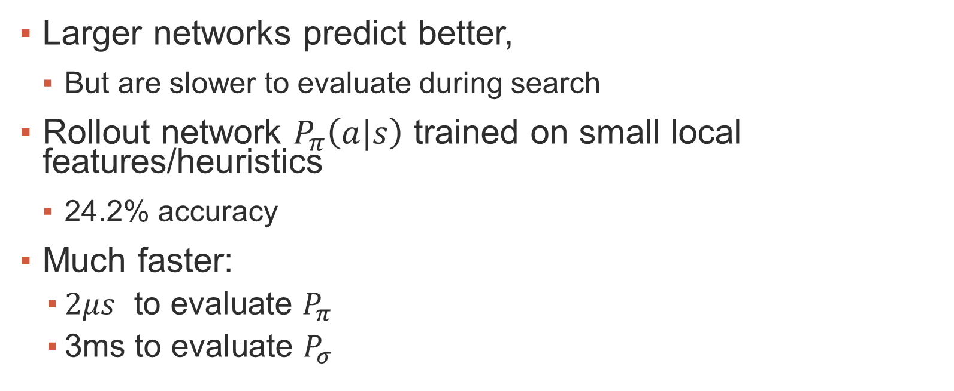
Rollout Policy Network $P_{π}$
Larger networks predict better,
But are slower to evaluate during search
Rollout network $P_{π}\left(a|s\right)$ trained on small local features/heuristics
24.2% accuracy
Much faster:
$2μs$ to evaluate $P_{π}$
3ms to evaluate $P_{σ}$

Slide 26
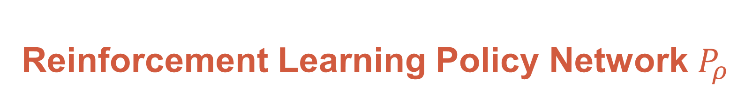
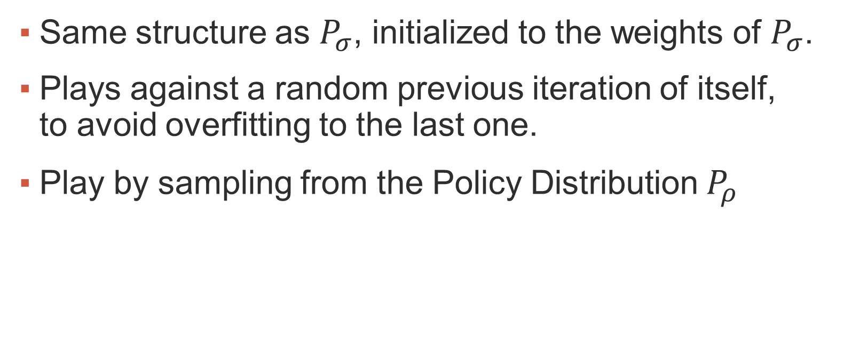
Reinforcement Learning Policy Network $P_{ρ}$
Same structure as $P_{σ}$, initialized to the weights of $P_{σ}$.
Plays against a random previous iteration of itself, to avoid overfitting to the last one.
Play by sampling from the Policy Distribution $P_{ρ}$

Slide 27
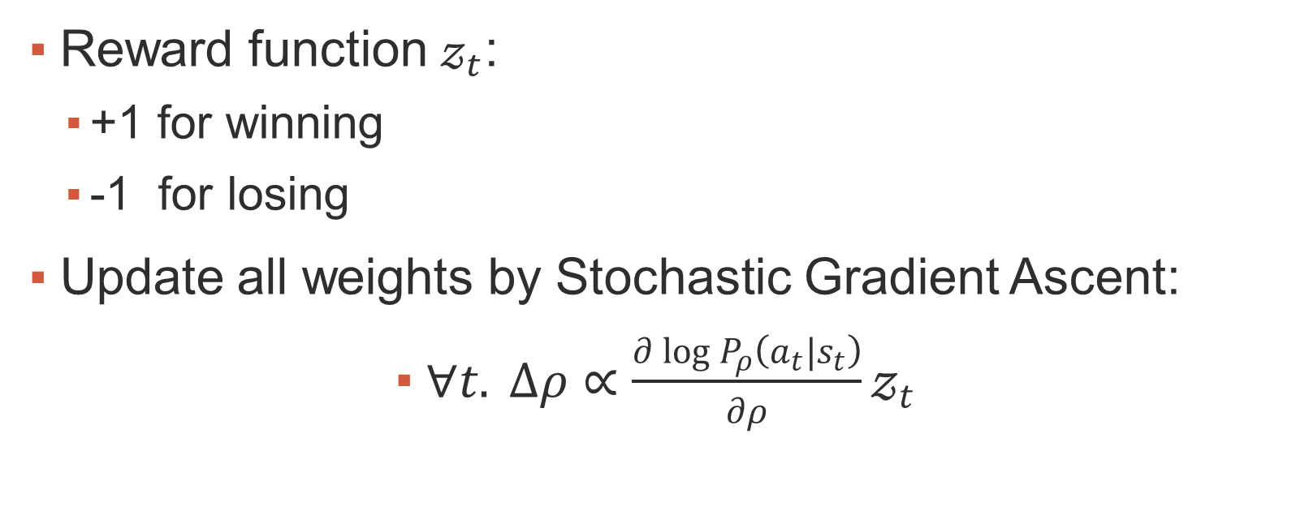
Reinforcement Learning Policy Network $P_{ρ}$
Reward function $𝓏_{t}$:
+1 for winning
-1 for losing
Update all weights by Stochastic Gradient Ascent:
$∀t. Δρ∝\frac{∂\log{P_{ρ}\left(a_{t}|s_{t}\right)}}{∂ρ}𝓏_{t}$

Slide 28

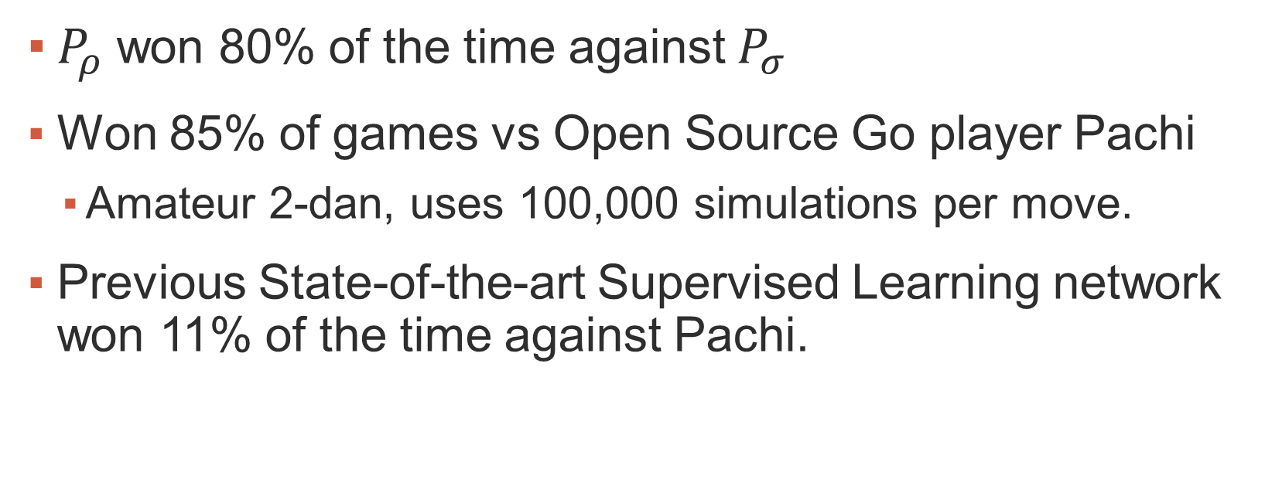
RL Policy Network $P_{ρ}$: Evaluation
$P_{ρ}$ won 80% of the time against $P_{σ}$
Won 85% of games vs Open Source Go player Pachi
Amateur 2-dan, uses 100,000 simulations per move.
Previous State-of-the-art Supervised Learning network won 11% of the time against Pachi.

Slide 29
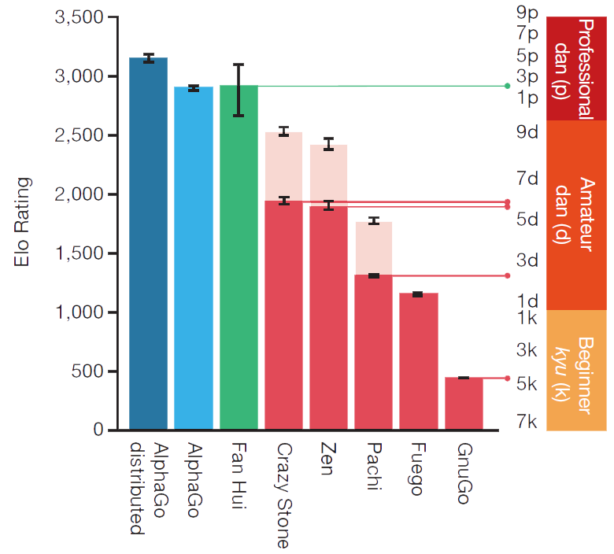

Dan & Elo scale
+1 Dan ~ +230 Elo
+230 Elo wins 79% of the time $⟹$ Exponential Scale

Slide 30
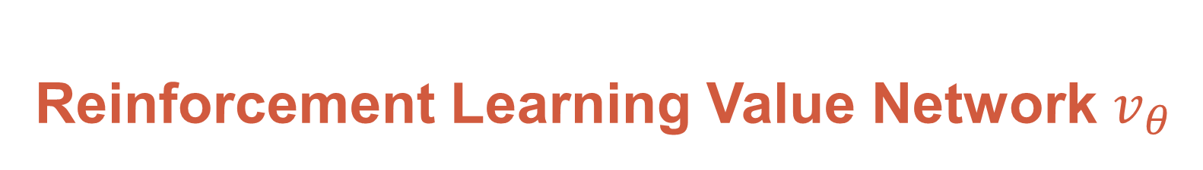
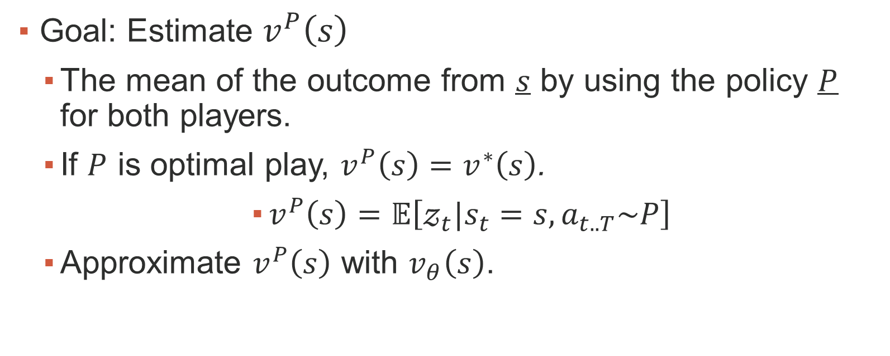
Reinforcement Learning Value Network $v_{θ}$
Goal: Estimate $v^{P}\left(s\right)$
The mean of the outcome from $s$ by using the policy $P$ for both players.
If $P$ is optimal play, $v^{P}\left(s\right)=v^{∗}\left(s\right)$.
$v^{P}\left(s\right)=𝔼\left[𝓏_{t}|s_{t}=s, a_{t..T}\sim P\right]$
Approximate $v^{P}\left(s\right)$ with $v_{θ}\left(s\right)$.

Slide 31
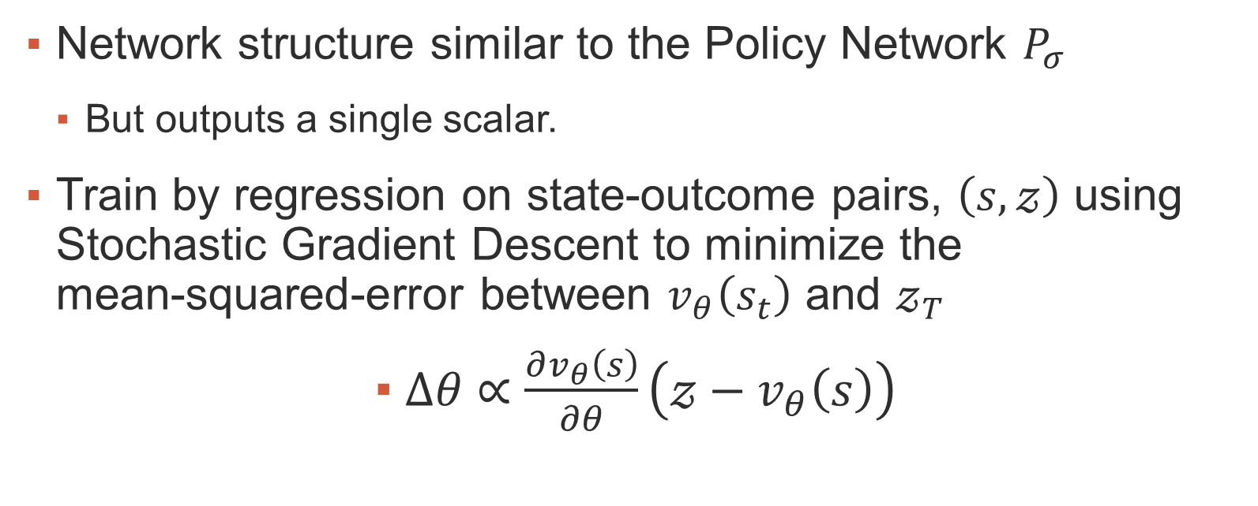
Reinforcement Learning Value Network $v_{θ}$
Network structure similar to the Policy Network $P_{σ}$
But outputs a single scalar.
Train by regression on state-outcome pairs, $\left(s,𝓏\right)$ using Stochastic Gradient Descent to minimize the mean-squared-error between $v_{θ}\left(s_{t}\right)$ and $𝓏_{T}$
$Δθ∝\frac{∂v_{θ}\left(s\right)}{∂θ}\left(𝓏−v_{θ}\left(s\right)\right)$

Slide 32

Value Network $v_{θ}$: Training
Naïve training leads to overfitting
Successive boards very similar, with same result.
Training: MSE = 0.19 Test: MSE = 0.37
Solution: Train on larger set, generated by self-play.
1 State sampled per game.
Training: MSE = 0.226 Test: MSE = 0.234
Not much overfitting

Slide 33

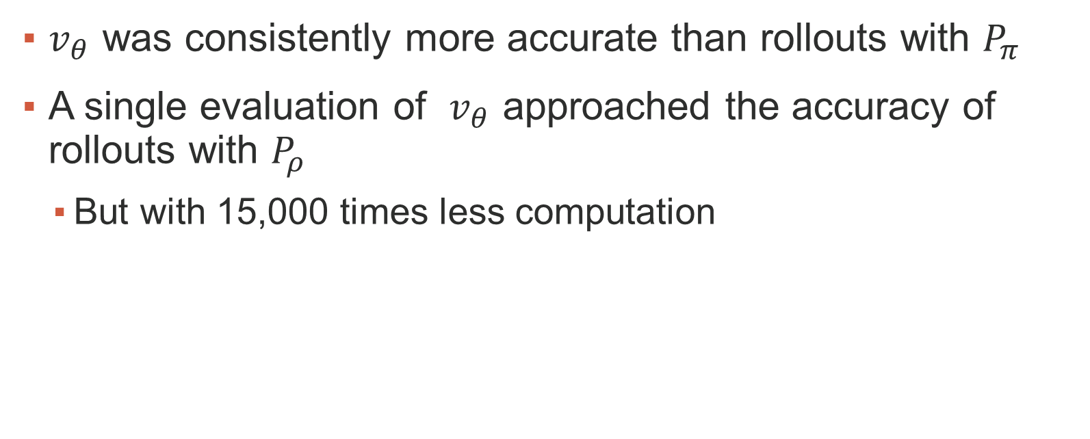
Value Network $v_{θ}$: Quality
$v_{θ}$ was consistently more accurate than rollouts with $P_{π}$
A single evaluation of $v_{θ}$ approached the accuracy of rollouts with $P_{ρ}$
But with 15,000 times less computation

Slide 34
MCTS - Monte Carlo Tree Search
Build an assymetric search tree
Use more time on promising subtrees
But explore too: maybe there is a hidden treasure somewhere.
Proven to converge to true minimax value asymptotically

Slide 35
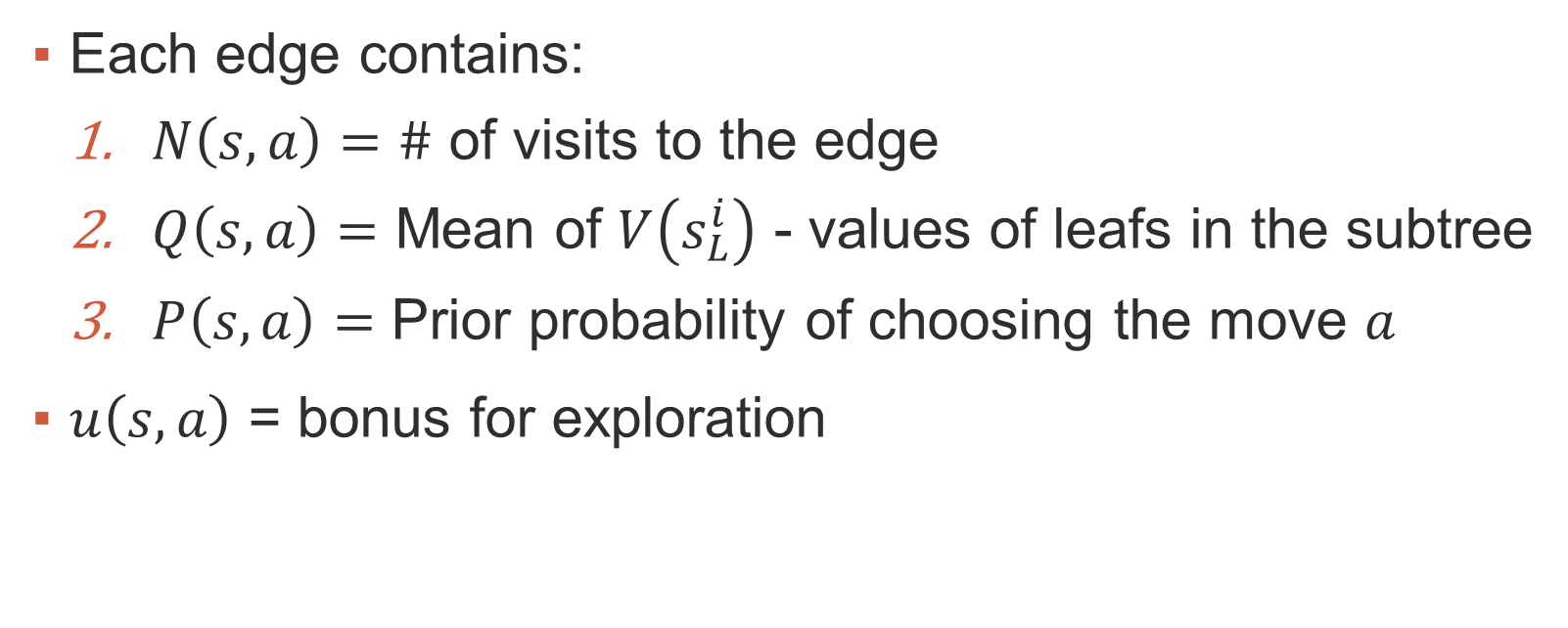
MCTS - Monte Carlo Tree Search
Each edge contains:
$N\left(s,a\right)=\#$ of visits to the edge
$Q\left(s,a\right)=$ Mean of $V\left(s_{L}^{i}\right)$ - values of leafs in the subtree
$P\left(s,a\right)=$ Prior probability of choosing the move $a$
$u\left(s,a\right)$ = bonus for exploration

Slide 36
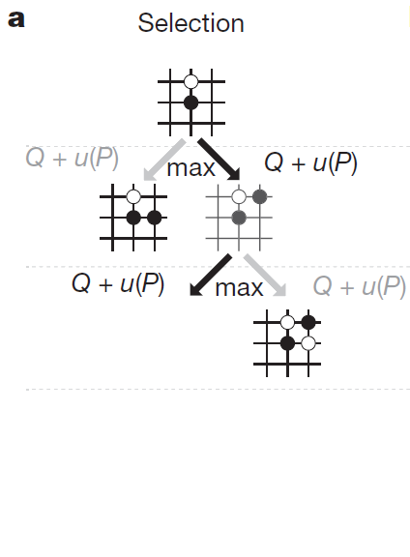
MCTS - Monte Carlo Tree Search

Slide 37
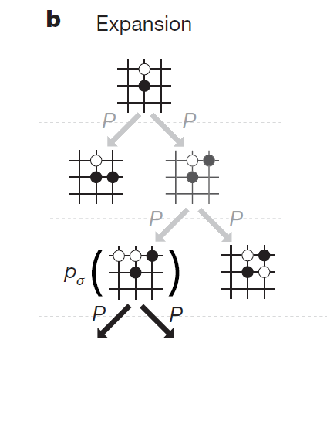
MCTS - Monte Carlo Tree Search

Slide 38
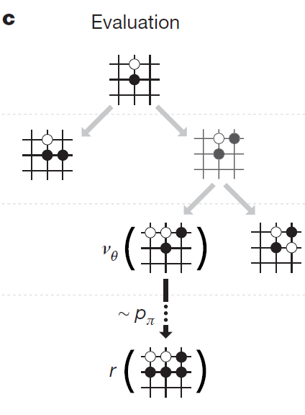
MCTS - Monte Carlo Tree Search

Slide 39
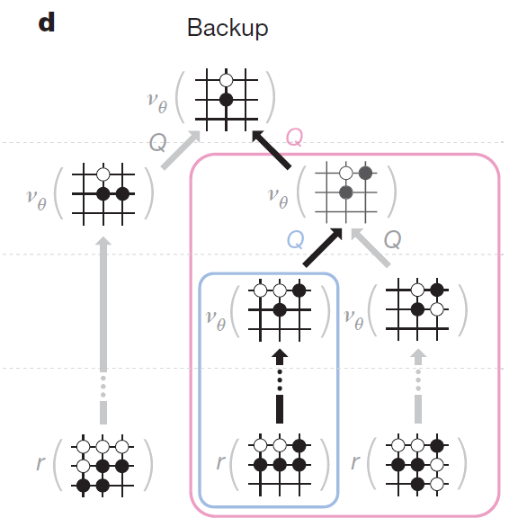
MCTS - Monte Carlo Tree Search

Slide 40
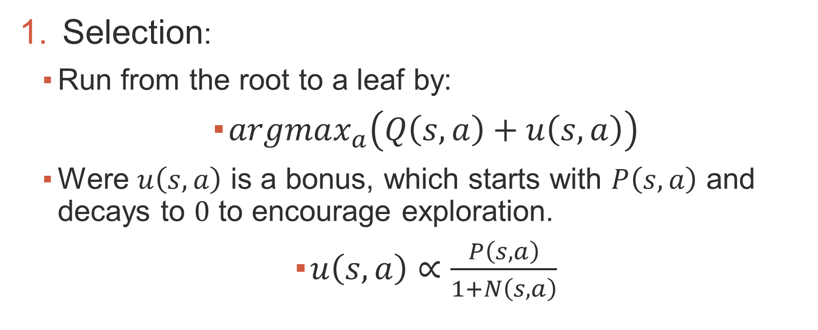
MCTS with Policy & Value Networks
Selection:
Run from the root to a leaf by:
$argmax_{a}\left(Q\left(s,a\right)+u\left(s,a\right)\right)$
Were $u\left(s,a\right)$ is a bonus, which starts with $P\left(s,a\right)$ and decays to $0$ to encourage exploration.
$u\left(s,a\right)∝\frac{P\left(s,a\right)}{1+N\left(s,a\right)}$

Slide 41
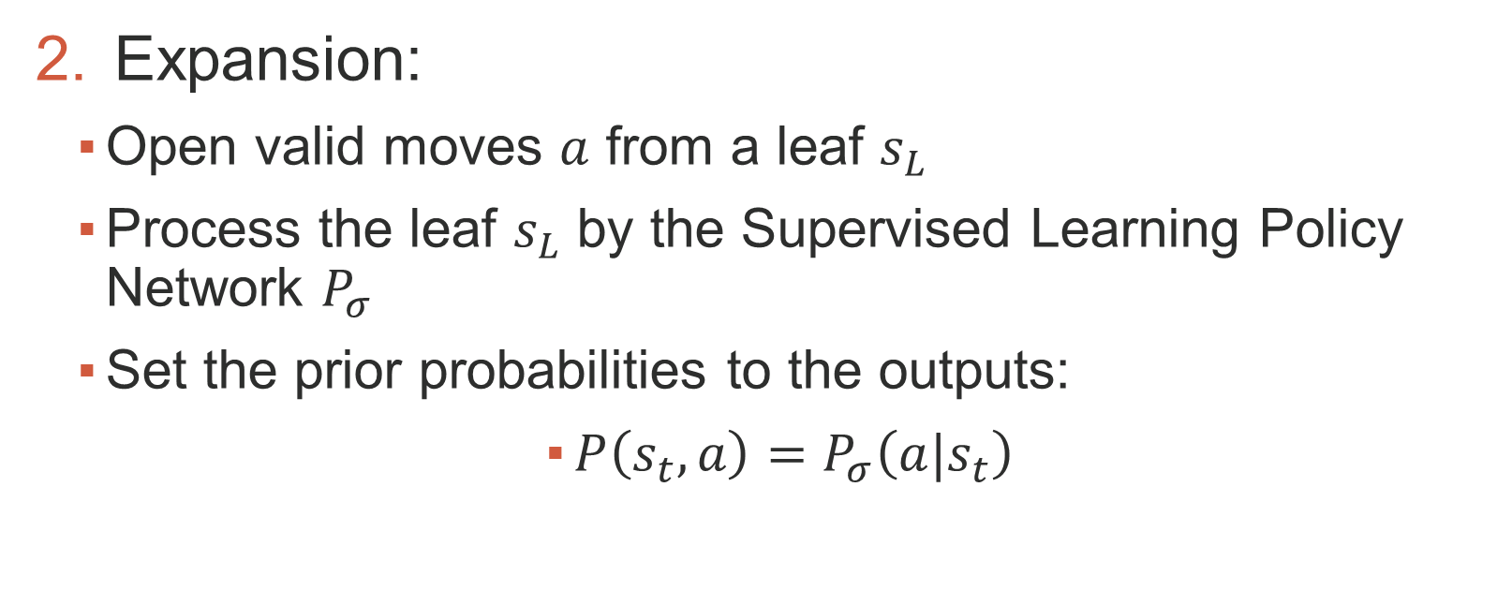
MCTS with Policy & Value Networks
Expansion:
Open valid moves $a$ from a leaf $s_{L}$
Process the leaf $s_{L}$ by the Supervised Learning Policy Network $P_{σ}$
Set the prior probabilities to the outputs:
$P\left(s_{t},a\right)=P_{σ}\left(a|s_{t}\right)$

Slide 42
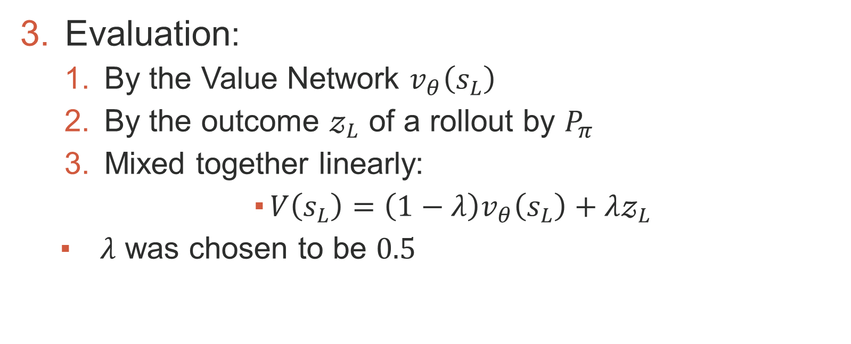
MCTS with Policy & Value Networks
Evaluation:
By the Value Network $v_{θ}\left(s_{L}\right)$
By the outcome $𝓏_{L}$ of a rollout by $P_{π}$
Mixed together linearly:
$V\left(s_{L}\right)=\left(1−λ\right)v_{θ}\left(s_{L}\right)+λ𝓏_{L}$
$λ$ was chosen to be $0.5$

Slide 43
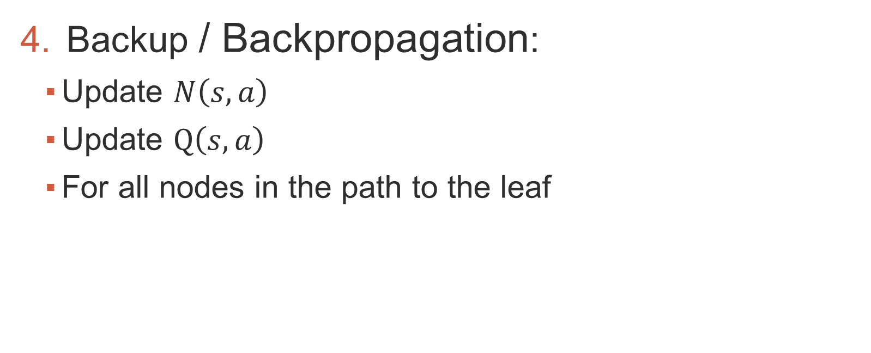
MCTS with Policy & Value Networks
Backup / Backpropagation:
Update $N\left(s,a\right)$
Update $Q\left(s,a\right)$
For all nodes in the path to the leaf

Slide 44
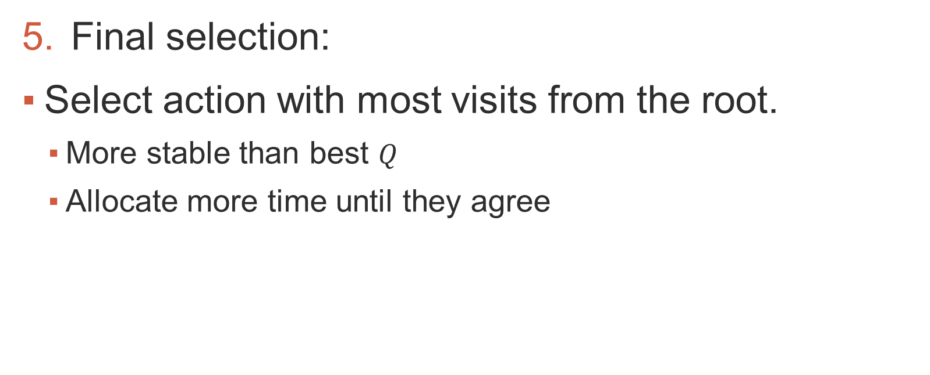
MCTS with Policy & Value Networks
Final selection:
Select action with most visits from the root.
More stable than best $Q$
Allocate more time until they agree

Slide 45
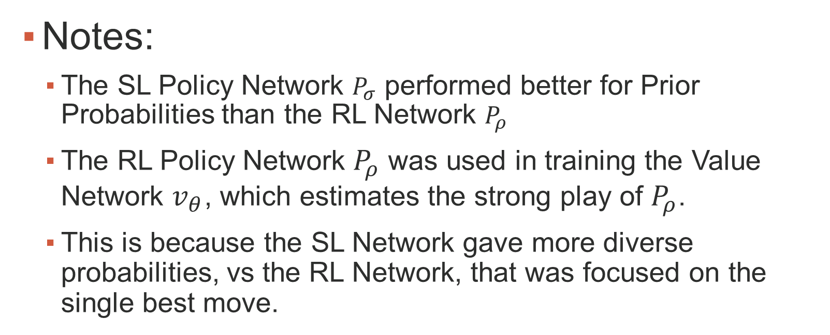
MCTS with Policy & Value Networks: Notes
Notes:
The SL Policy Network $P_{σ}$ performed better for Prior Probabilities than the RL Network $P_{ρ}$
The RL Policy Network $P_{ρ}$ was used in training the Value Network $v_{θ}$, which estimates the strong play of $P_{ρ}$.
This is because the SL Network gave more diverse probabilities, vs the RL Network, that was focused on the single best move.

Slide 46
AlphaGo Execution
Distributed Execution:
Master CPU: The search tree
Slave CPUs: Rollouts
Slave GPUs: Value & Policy Networks
Virtual loss: To prevent different threads traversing the same paths

Slide 47
AlphaGo Execution
Time management:
Give more time for mid-game
Ethics:
Resign if winning probability low (<20%)

Slide 48
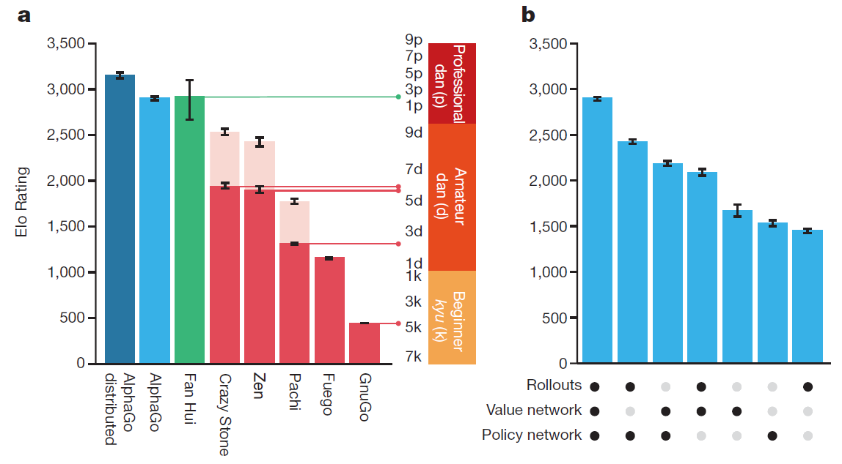
AlphaGo performance

Slide 49
Discussion
Beat Lee Sedol, 9-Dan Go player, world champion
4/5 games
Evaluated thousands of times less positions than DeepBlue
No hand-crafted evaluation function

Slide 50
Discussion
MCTS led to many advances in:
General Game Playing (GGP)
Planning
Scheduling
Constraint Satisfaction
Feature Selection
& Many more!

Slide 51
Discussion
AI Grand Challenge Completed
Starcraft next up!
Partial information
Continuous
Real-time

Slide 52
Resources
Silver, David, et al. "Mastering the game of Go with deep neural networks and tree search." Nature 529.7587 (2016): 484-489.‏
Browne, Cameron B., et al. "A survey of monte carlo tree search methods." Computational Intelligence and AI in Games, IEEE Transactions on 4.1 (2012): 1-43.‏
Artificial Intelligence and The Future

Slide 53
Thank you!

